Slide 1
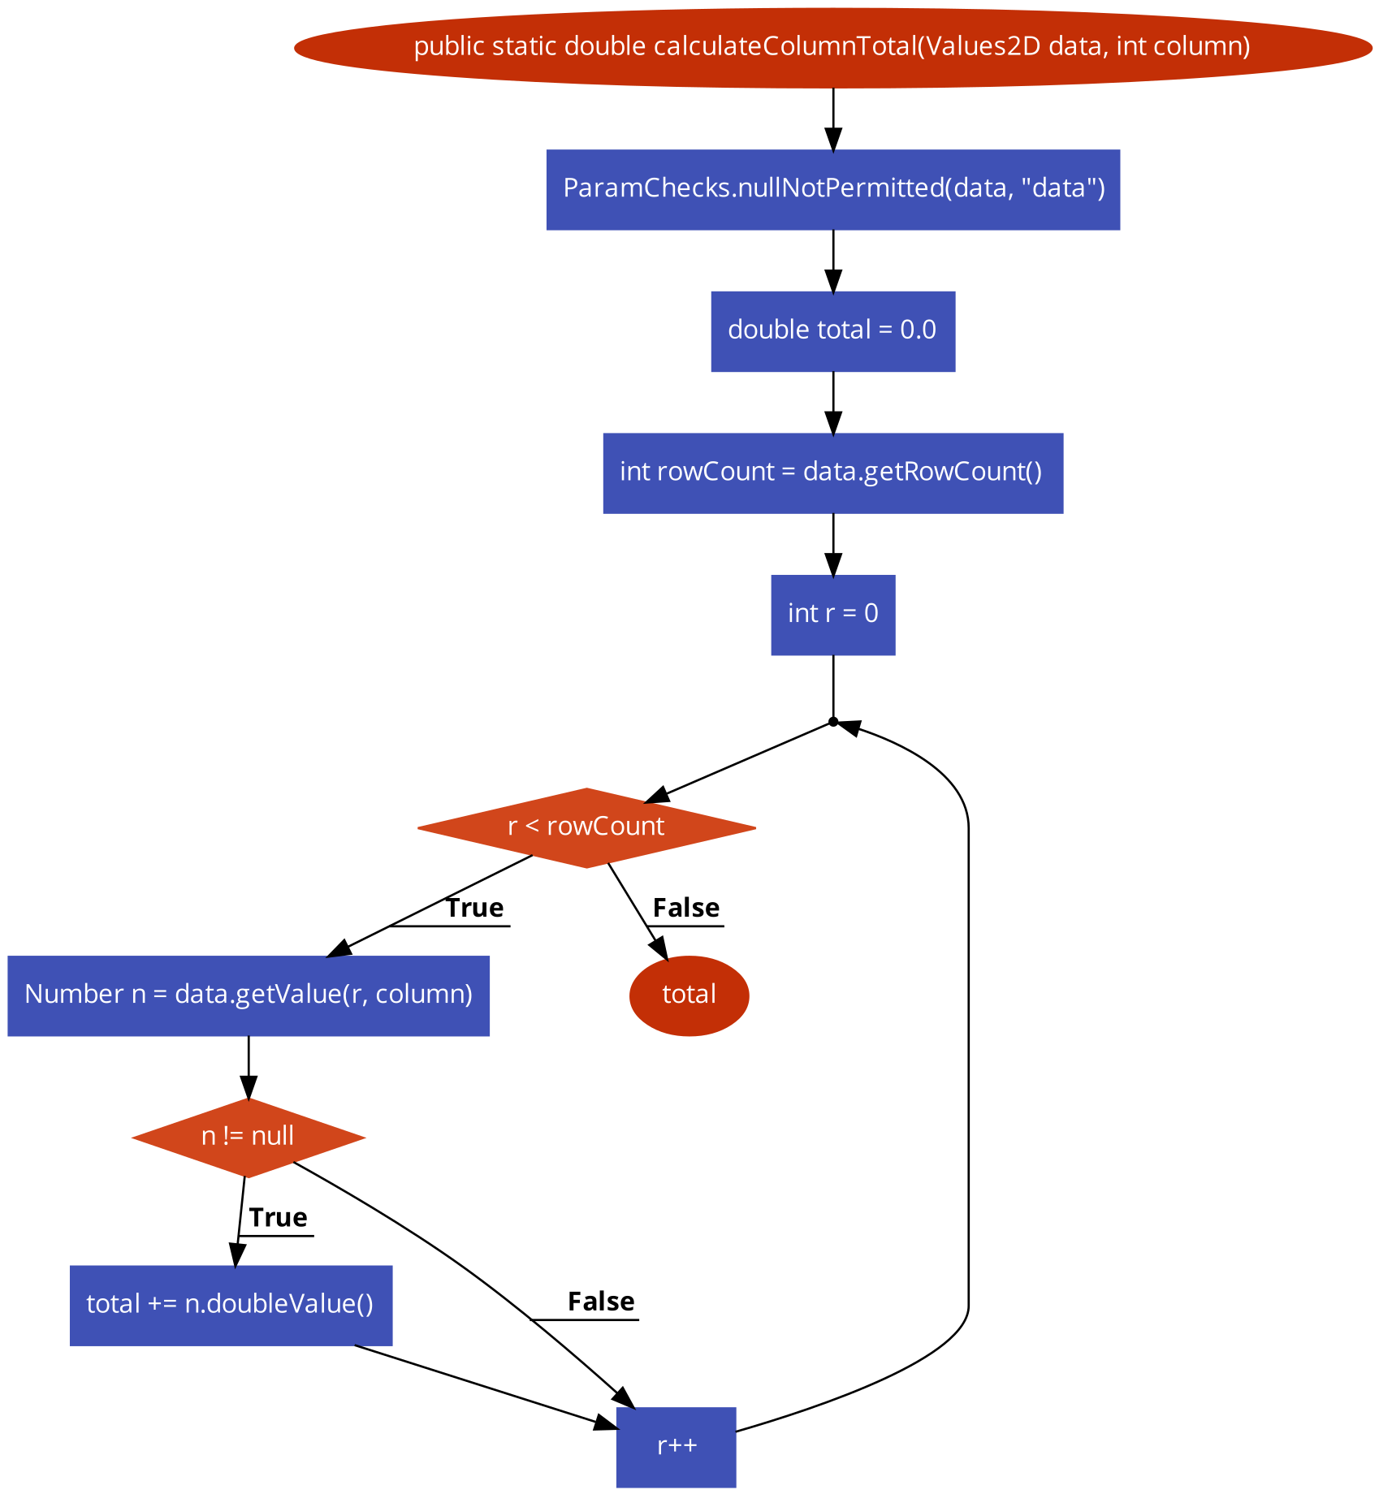
(1,1)
n1
Definition of pairs:
(where value is assigned, where it is used)
n2
(1,3)
n3
n4
data
column
n5
(<4, 10>,5), (3,5)
(1,7),(1,7),(<4, 10>,7)
n7
n6
(<2,9>,6)
(7,8)
n8
(<2,9>,9), (7,9)
n9
n10
(<4, 10>,10)

Slide 2
Per Variable
data: (1,3), (1,1), (1,7)
column: (1,7)
total:(<2,9>,6),(<2,9>,9)
rowCount: (3,5)
r: (<4,10>,5), (<4,10>,7), (<4,10>,10)
n: (7,8), (7,9)

Slide 3
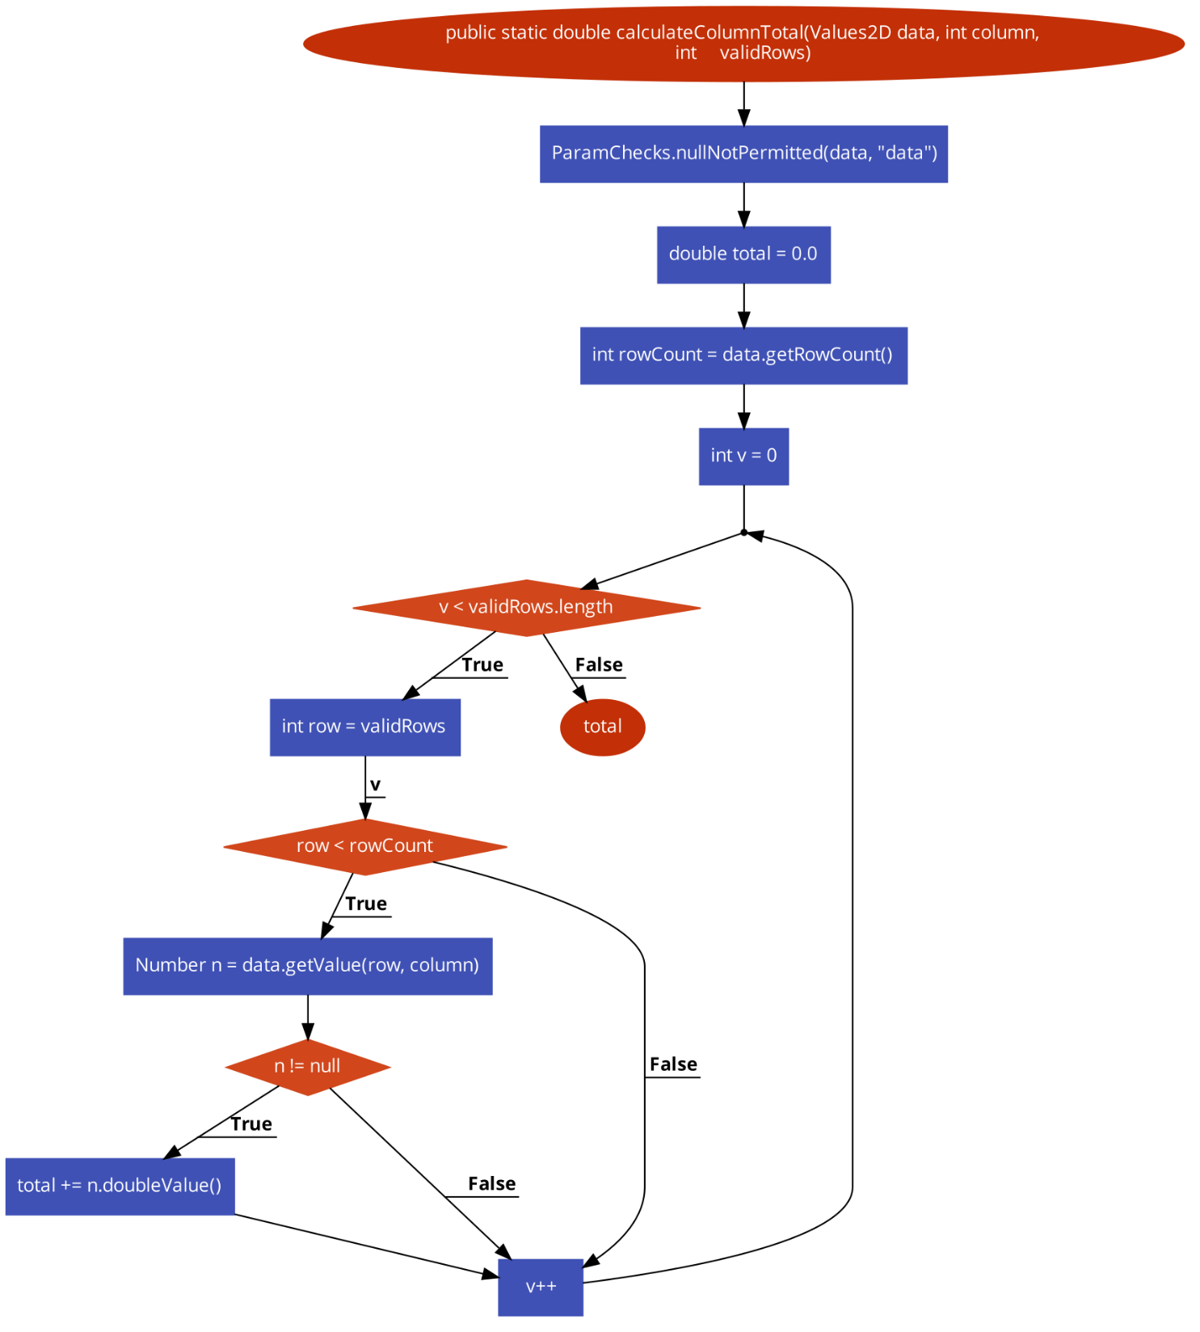
(1,1)
n1
Definition of pairs:
(where value is assigned, where it is used)
n2
(1,3)
n3
n4
n5
(<4, 12>,5), (1,5)
(1,7),(<4, 10>,7)
n7
n6
(<2,11>,6)
(7,8), (3,8)
n8
data
(1,9), (1,9), (7,9)
n9
column
(9,10)
n10
(9,11)
n11
n12
(<4, 12>,12)

Slide 4
Per Variable
data: (1,3), (1,1), (1,9)
column: (1,9)
total:(<2,11>,6),(<2,11>,11)
validRows:(1,5), (1,7)
rowCount: (3,8)
v: (<4,12>,5), (<4,12>,12)
n: (9,10), (9,11)

Slide 5
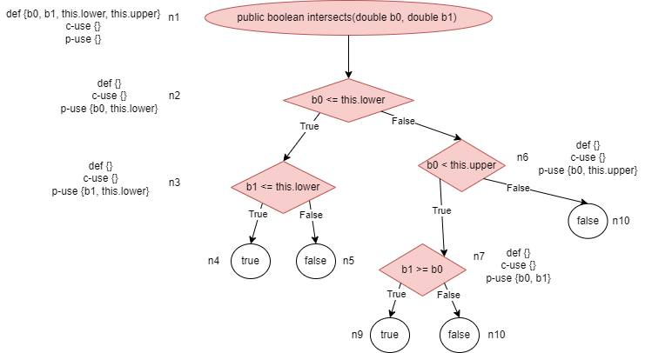

Slide 6
